Slide 1

Text Classification using GCN
Shivanjali Vijaykumar Ranashing

Slide 2
Index
Problem Statement
Structure of Graph
Dataset Details
Graph Details
Neural Network Structure and results
Results [Two methods → Word Classification and Document Classification]

Slide 3
Problem Statement
Implementing text classification using Supervised and Semi-supervised learning using Graph Convolution Network (GCN) on Un-directed graph.

Slide 4
Structure of Graph
Single graph for words and documents.
Nodes
Document Nodes
Word Nodes
Edges
Document to word edges
Word to word edges
TF-IDF
PMI

Slide 5
Dataset Details
Category | Number of files
Accounting | 284
Biology | 635
Geography | 98
Physics | 769
Maths | 214
History | 500
Computer Science | 642
Total Files | 3,142
Kaggle dataset: 7 topic data for text classification
Content of files collected from 11th or 12th grade schoolbooks and from other resources.
5 MB zip file, which as 3,142 files
https://www.kaggle.com/datasets/deepak711/4-subject-data-text-classification

Slide 6
Creating Graphs
Networkx library
Create Empty Graph
import networkx as nx
G = nx.Graph()
Add Nodes
G.add_node(1)
G.add_nodes_from([2,3])
Add Edges
G.add_edge(1,2)
G.add_edge([(1,2),(1,3)])

Slide 7
Current Dataset Details
Total Number of Document Nodes | 106
Total Number of Word Nodes | 4737
Total Number of Nodes (Document Nodes + Word Nodes) | 4843
Total Number of Document-to-word Edges | 12422
Total Number of Word-toword Edges | 57055
Total Number of Edges | 69477
Total Number of Document Nodes | 560
Total Number of Word Nodes | 14097
Total Number of Nodes (Document Nodes + Word Nodes) | 14657
Total Number of Document-to-word Edges | 70344
Total Number of Word-toword Edges | 292289
Total Number of Edges | 362633

Slide 8
No of files | Total no of unique words | Total no of edges | First Hidden layer size | Second Hidden layer size | Total no of epochs | Learning rate | Dataset Size |  | Loss |  | Accuracy
 |  |  |  |  |  |  | Training Dataset | Test Dataset | Training Dataset | Test Dataset | Training Dataset | Test Dataset
106 | 4843 | 69477 | 4843X300 | 300X120 | 1000 | 0.0001 | 85 | 21 | 1.147 | 1.33 | 0.741 | 0.523
106 | 4843 | 69477 | 4843X300 | 300X120 | 1000 | 0.0001 | 85 | 21 | 1.189 | 1.601 | 0.882 | 0.761
106 | 4843 | 69477 | 4843X300 | 300X120 | 1000 | 0.0001 | 85 | 21 | 1.112 | 1.315 | 0.905 | 0.761
106 | 4843 | 69477 | 4843X250 | 250X50 | 1000 | 0.0001 | 85 | 21 | 1.548 | 1.704 | 0.811 | 0.714
559 | 14646 | 362390 | 14646X300 | 300X120 | 1000 | 0.0001 | 447 | 112 | 1.663 | 1.723 | 0.449 | 0.366
560 | 14097 | 362633 | 14097X250 | 250X100 | 1000 | 0.0001 | 448 | 112 | 1.689 | 1.654 | 0.4308 | 0.4375

Slide 9
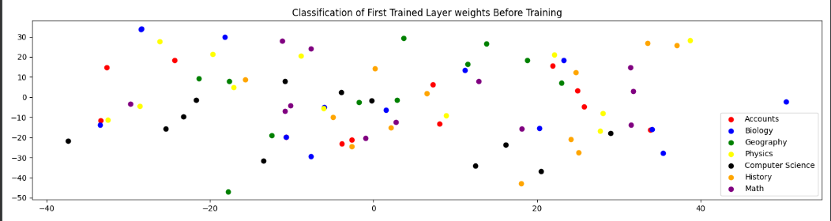
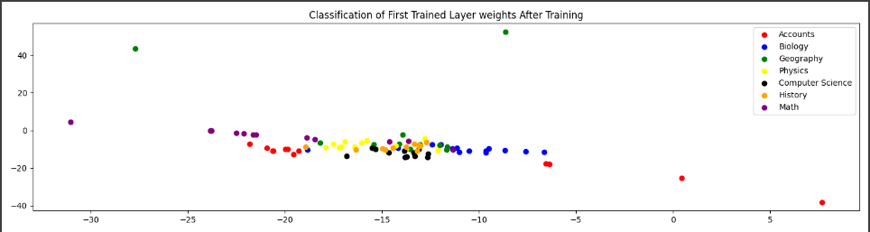
Result: No of Input Files → 106 (Training Dataset → 85 , Test Dataset → 21)

Slide 10
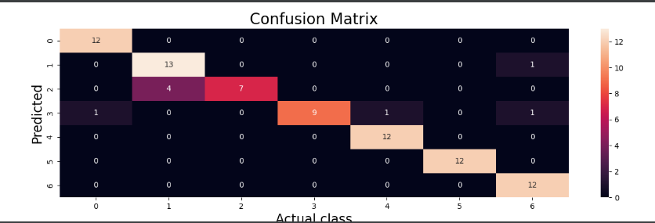

Slide 11
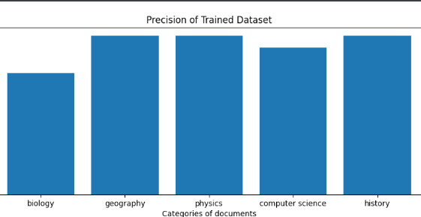

Slide 12
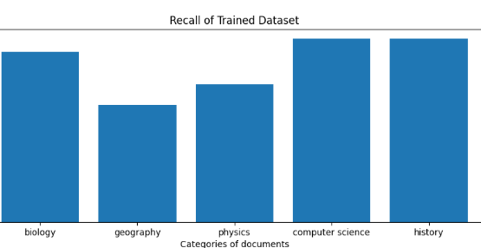

Slide 13
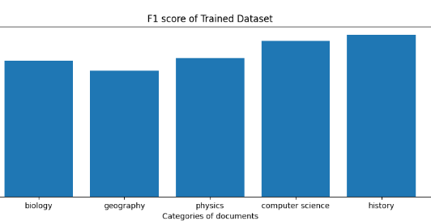

Slide 14
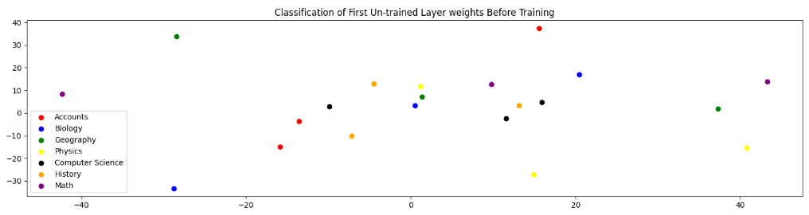
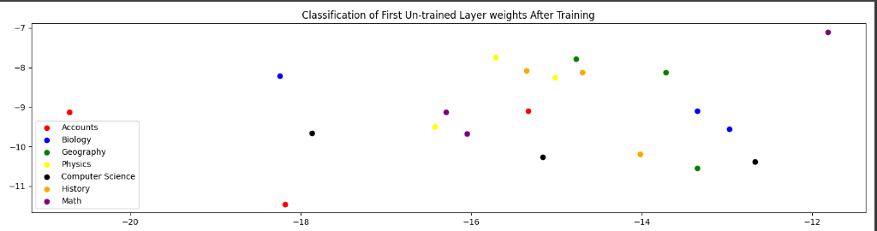

Slide 15
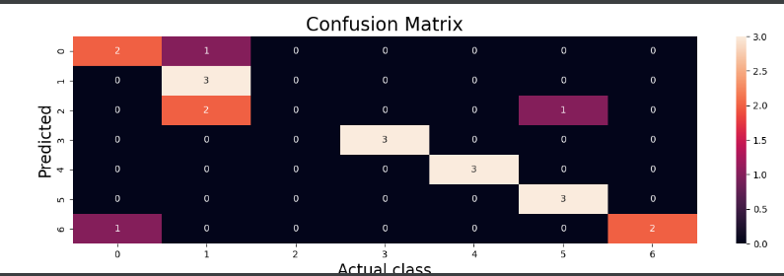

Slide 16
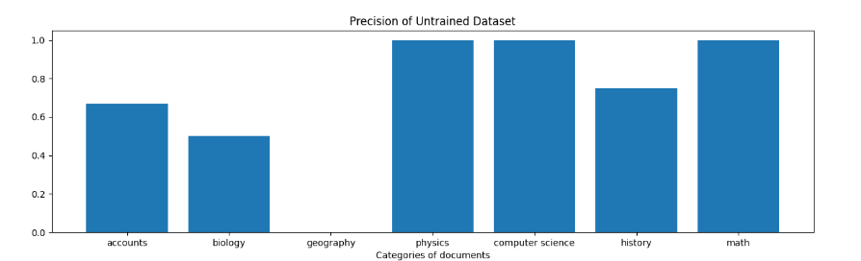

Slide 17
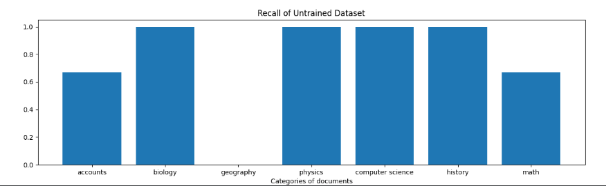

Slide 18
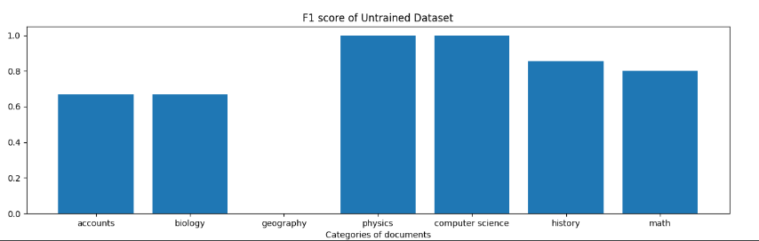

Slide 19
Text Classification

Slide 20
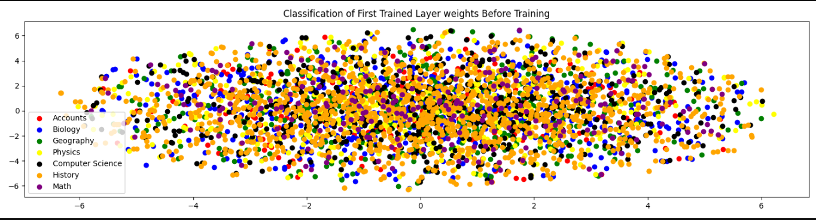

Slide 21
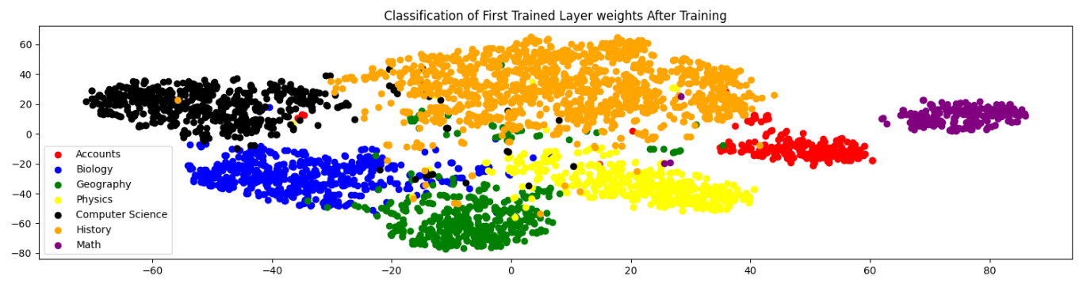

Slide 22
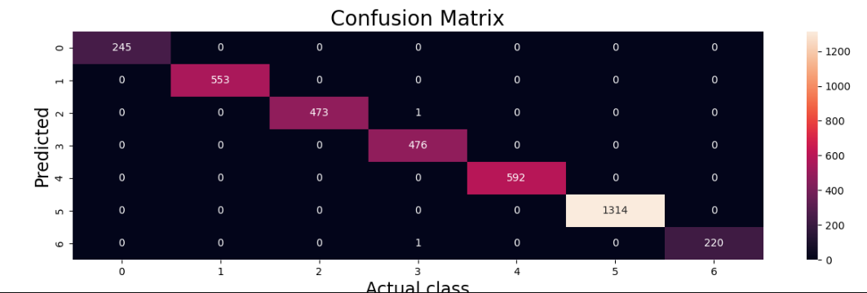

Slide 23
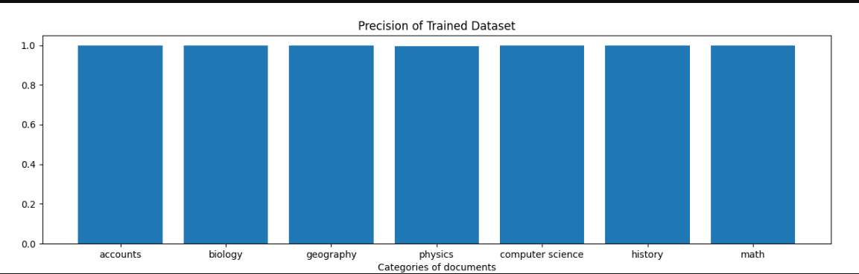

Slide 24
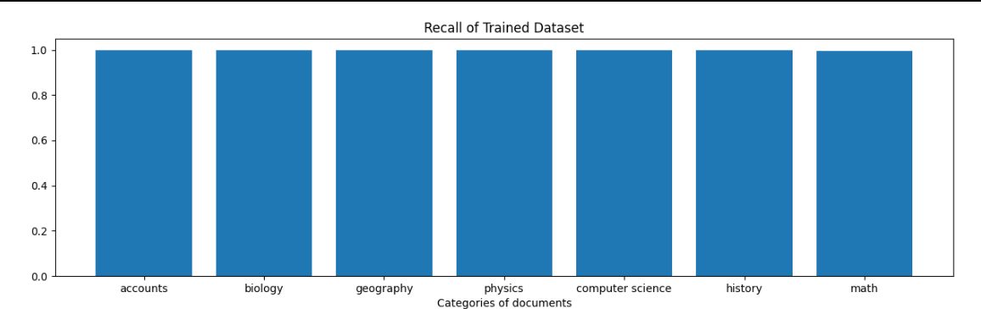

Slide 25
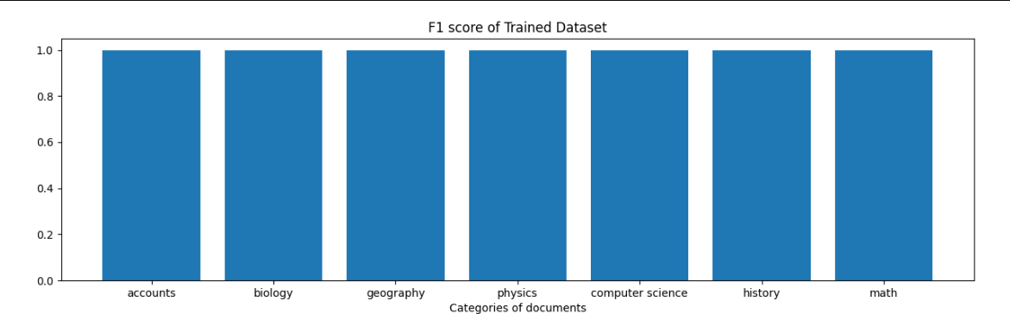

Slide 26
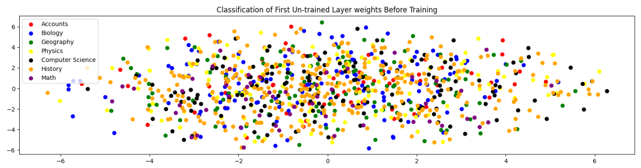

Slide 27
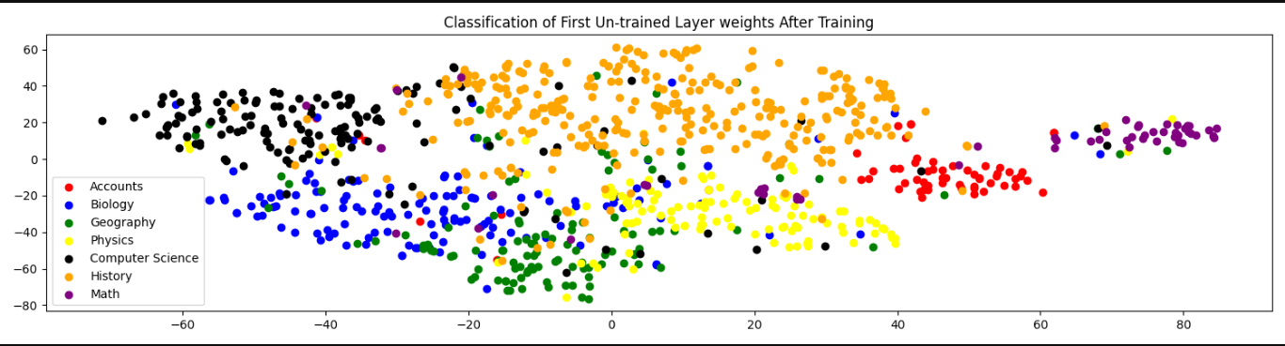

Slide 28
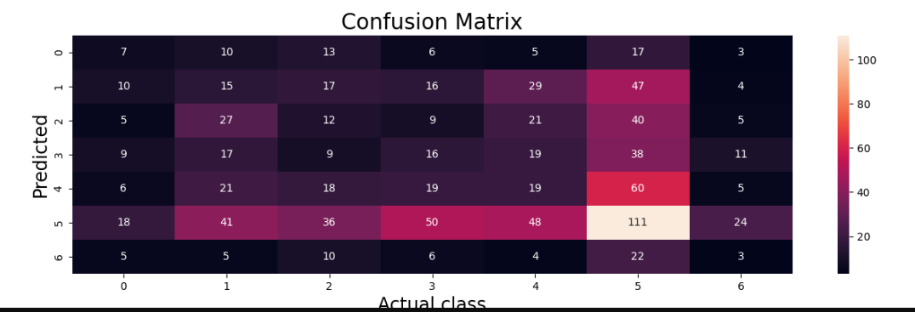

Slide 29
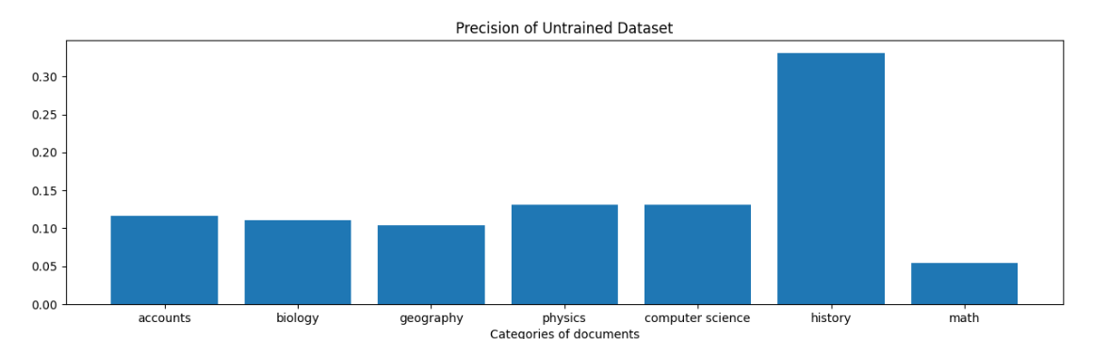

Slide 30
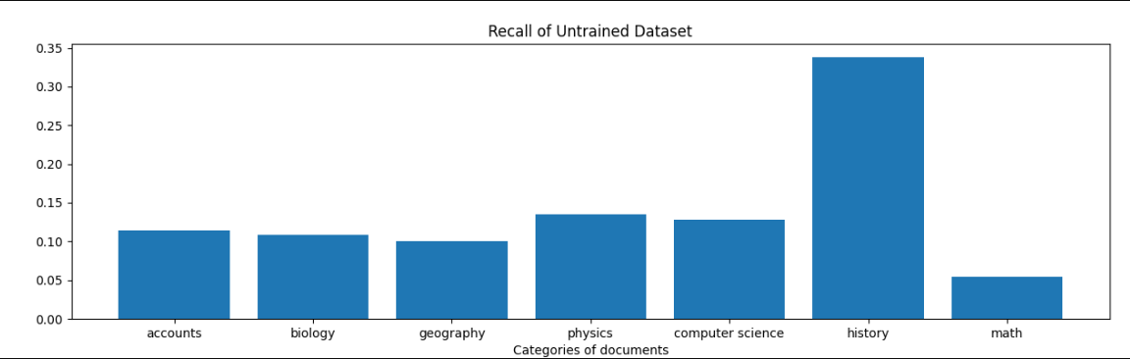

Slide 31
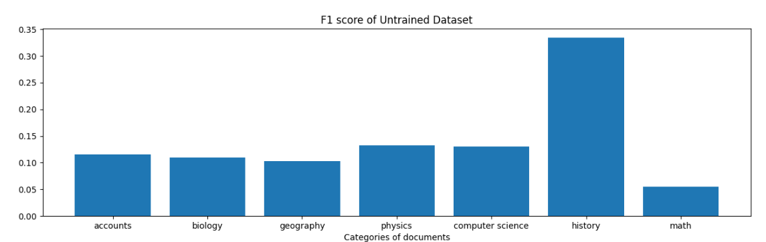

Slide 32
10/21/2022

Slide 33
 | 106 Datafiles | 560 Datafiles | 1000 Datafiles
Total No of words (Before preprocessing) | 38,096 | 2,09,981 | 4,07,037
Total No of words (After preprocessing) | 19,715 | 1,08,436 | 2,09,810
Unique Words | 4,676 | 13,949 | 20,976
Average Number of words in documents (Before Preprocessing) | 359.40 | 374.97 | 407.037
Average Number of words in documents (After Preprocessing) | 185.99 | 193.64 | 209.81

Slide 34
No of files | Total no of unique words | Total no of edges | First Hidden layer size | Second Hidden layer size | Total no of epochs | Learning rate | Dataset Size |  | Loss |  | Accuracy |  | Time
 |  |  |  |  |  |  | Training Dataset | Test Dataset | Training Dataset | Test Dataset | Training Dataset | Test Dataset
106 | 4676 | 69477 | 4843X300 | 300X120 | 1000 | 0.0001 | 85 | 21 | 1.176 | 1.269 | 0.917 | 0.857 | 2.8 mins
560 | 13949 | 358729 | 13949X400 | 400X200 | 3500 | 0.0001 | 448 | 112 | 0.949 | 0.887 | 0.877 | 0.758 | 70.75 mins
1000 | 20976 | 665537 | 20976X400 | 400X200 | 3500 | 0.0001 | 800 | 200 | 1.180 | 1.146 | 0.71625 | 0.605 | 2.85 hrs.
1000 | 20976 | 665537 | 20976X500 | 500X300 | 3500 | 0.0001 | 800 | 200 | 1.172 | 1.134 | 0.73625 | 0.62 | 3.80 hrs.
1000 | 20976 | 665537 | 20976X500 | 500X300 | 4500 | 0.0001 | 800 | 200 | 0.849 | 0.729 | 0.888 | 0.795 | 4.88 hrs.

Slide 35
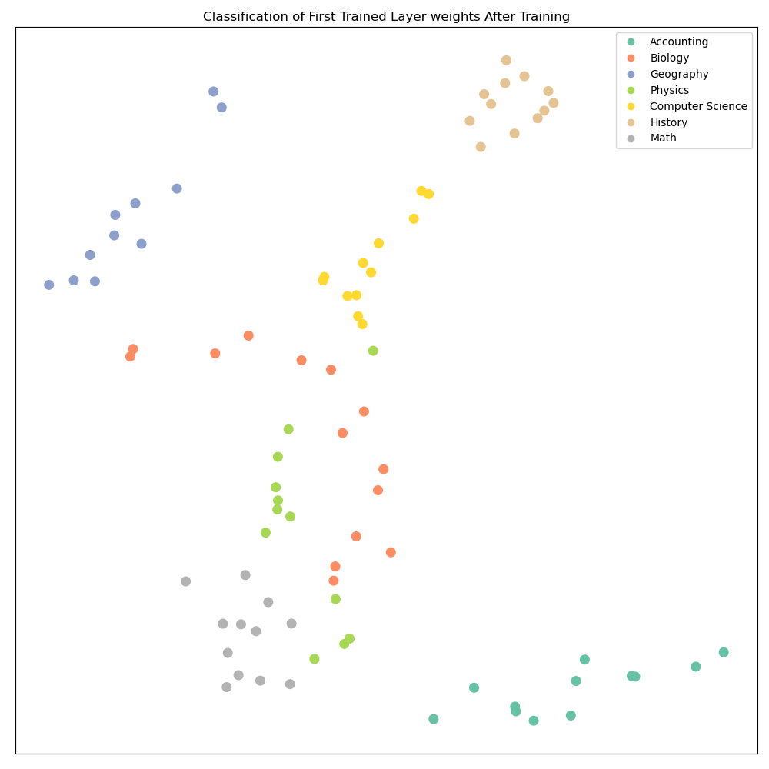
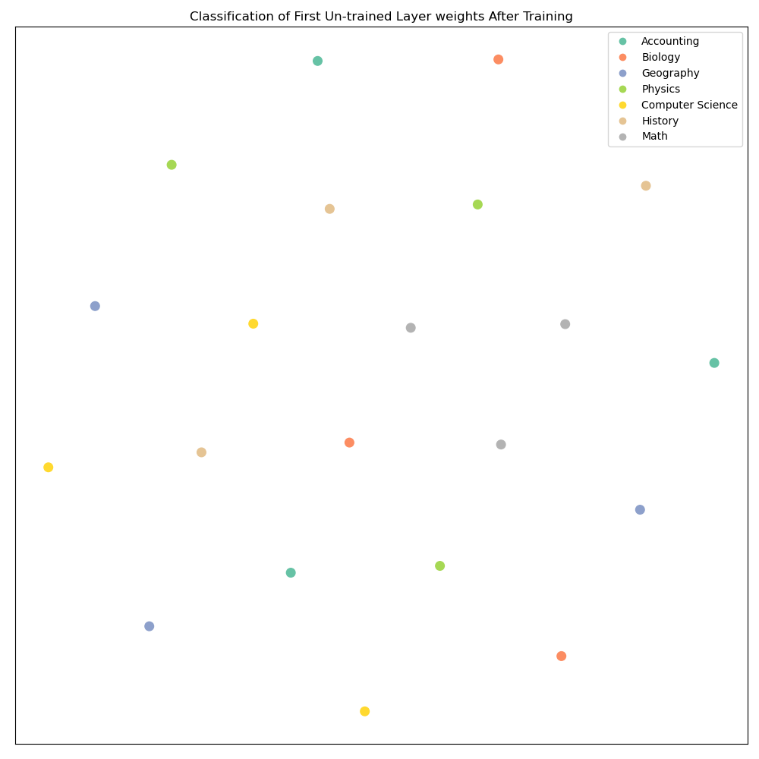
106 Number of Input Files

Slide 36
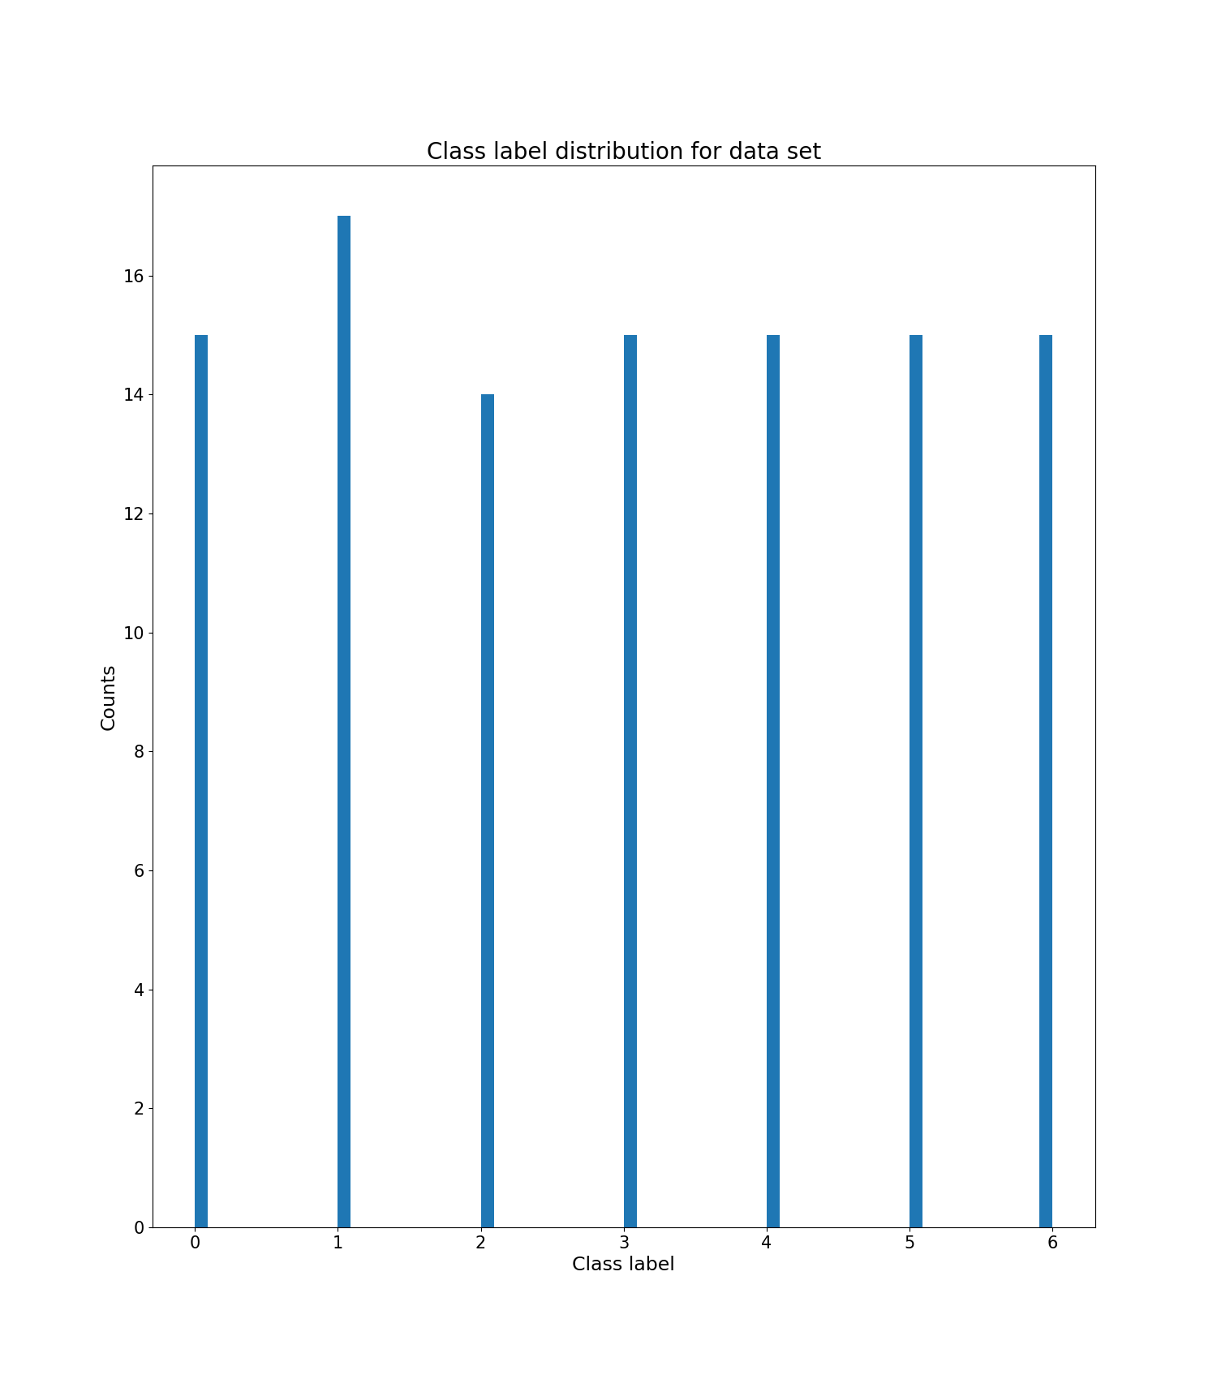
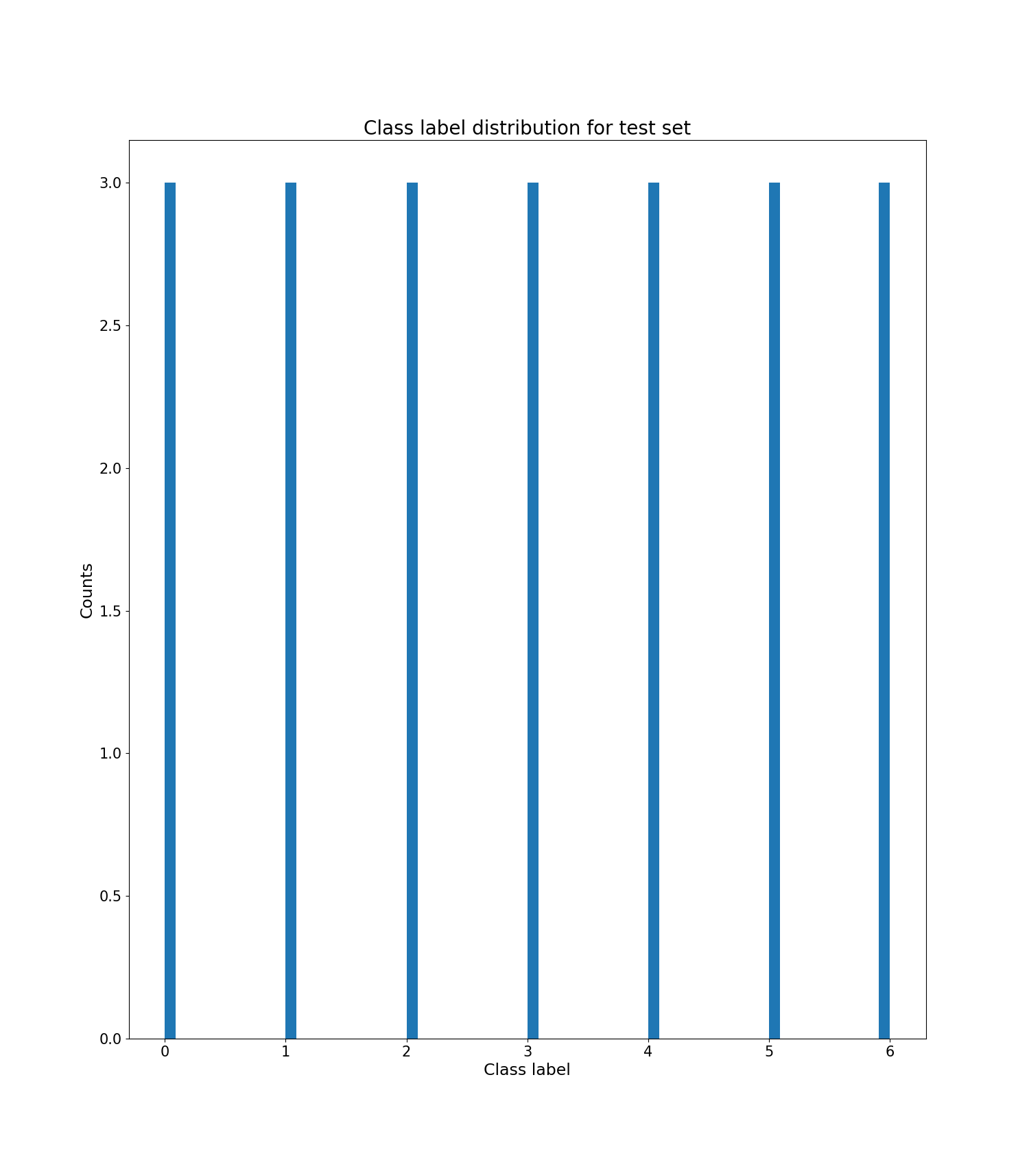

Slide 37
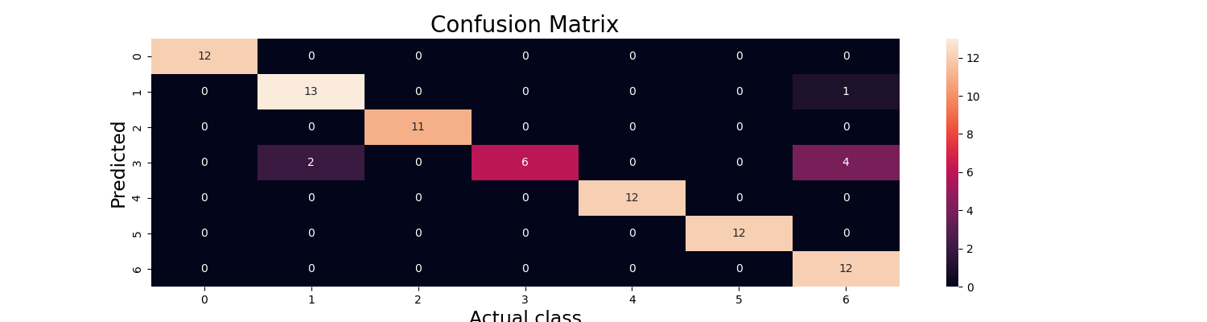
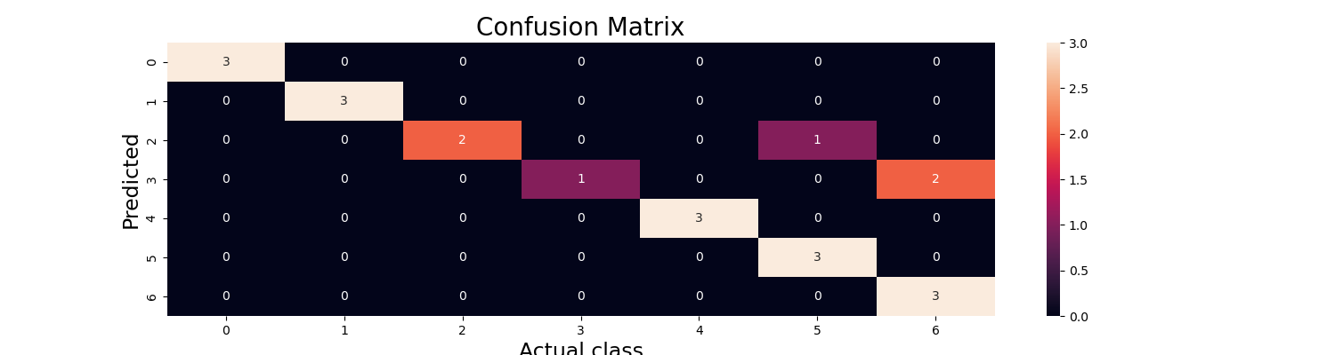

Slide 38
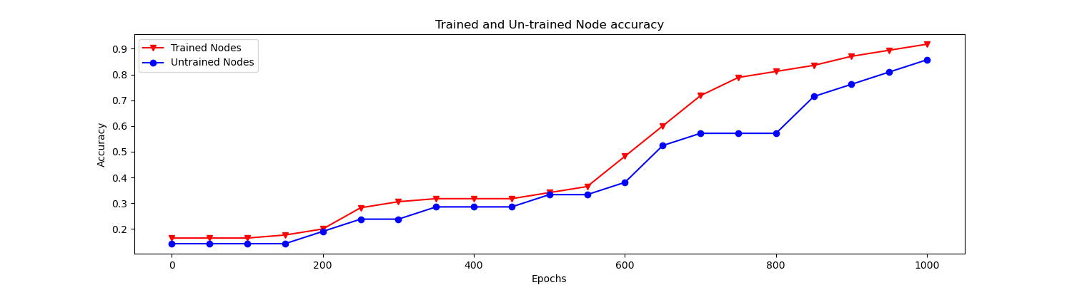
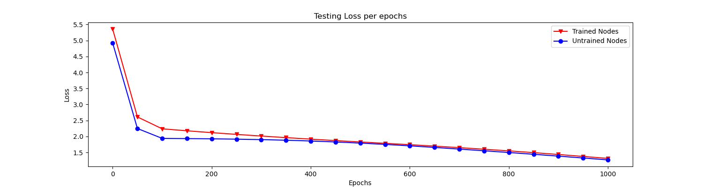

Slide 39
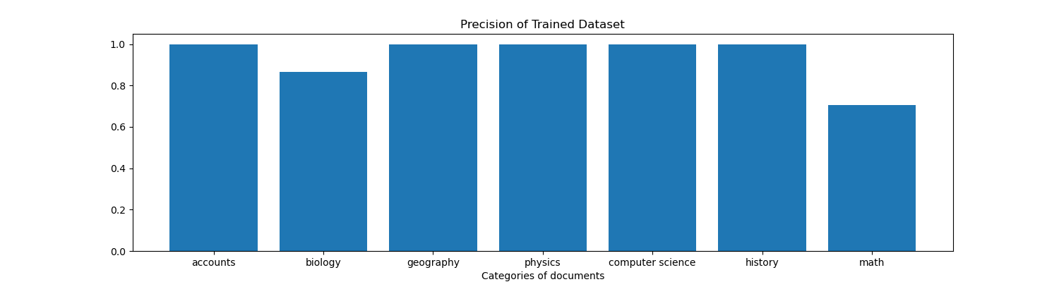
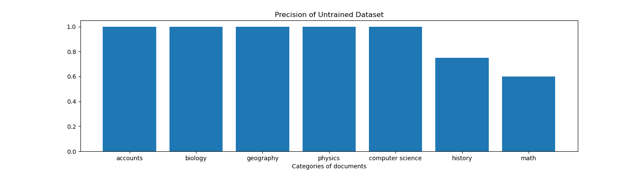

Slide 40
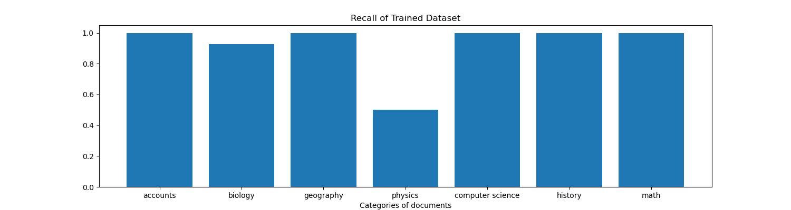
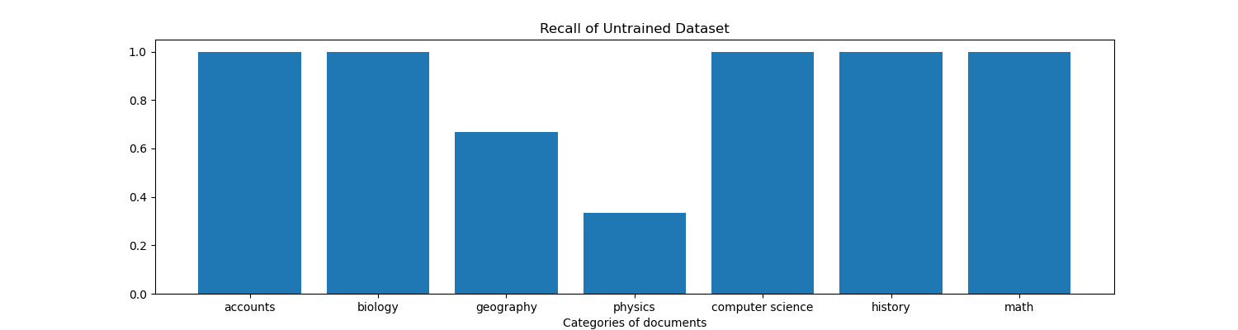

Slide 41
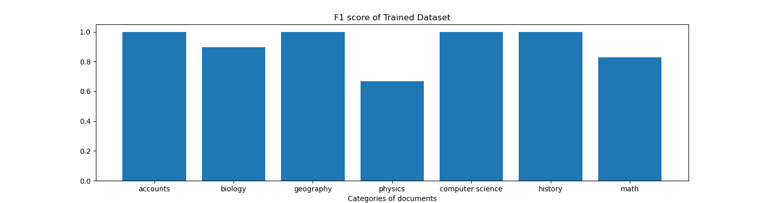
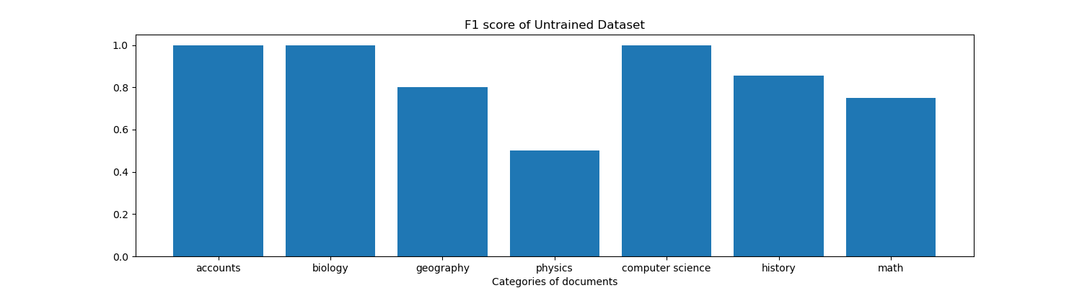

Slide 42
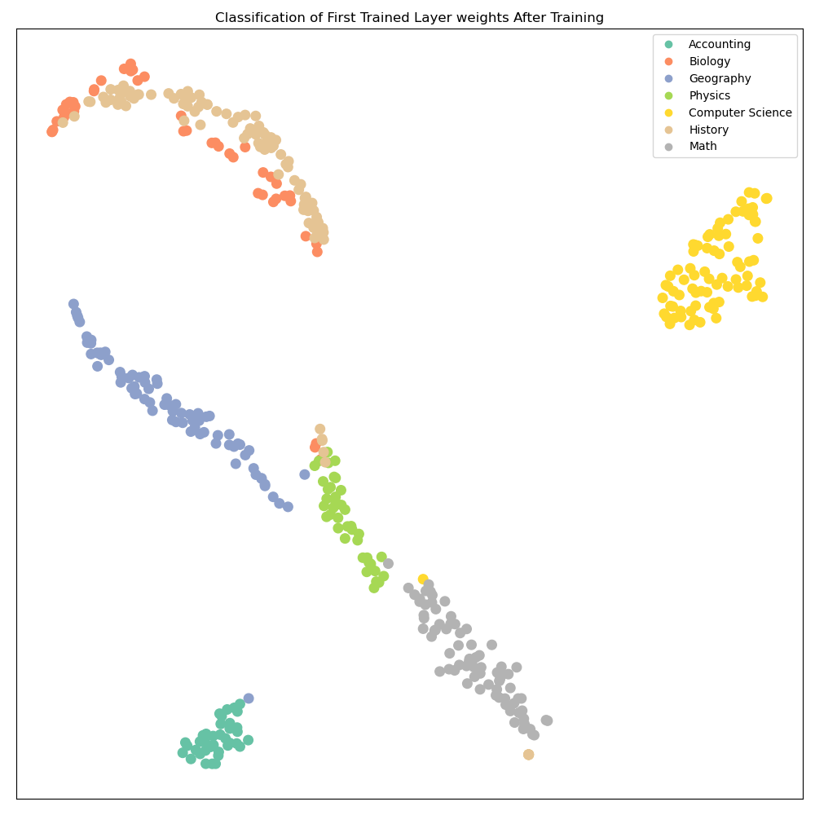
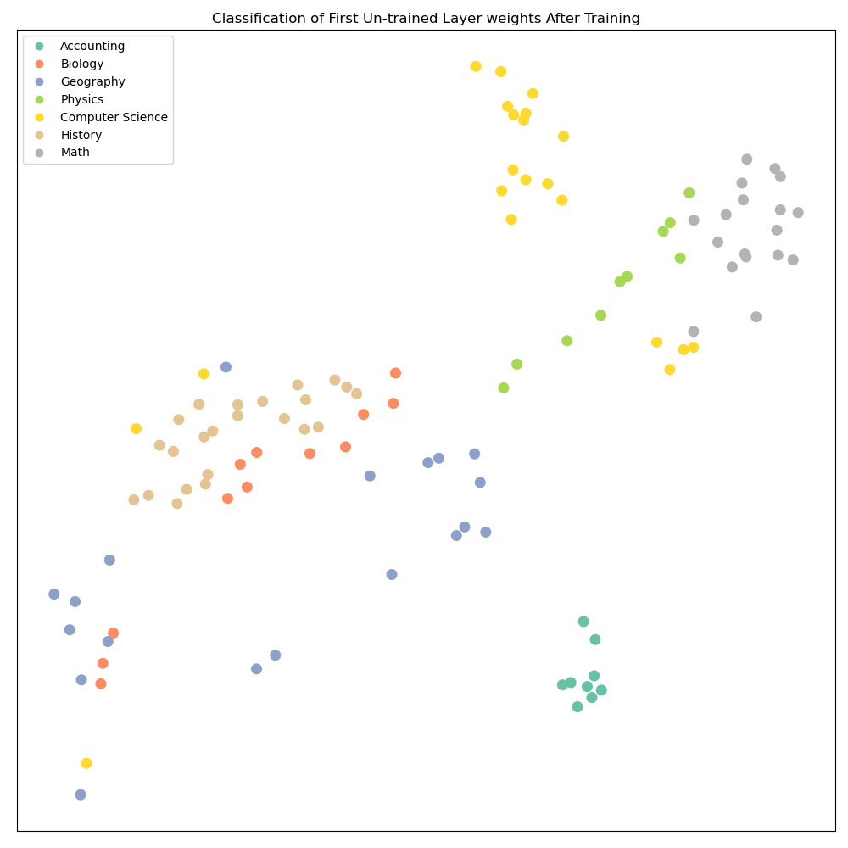
560 Number of Input Files

Slide 43
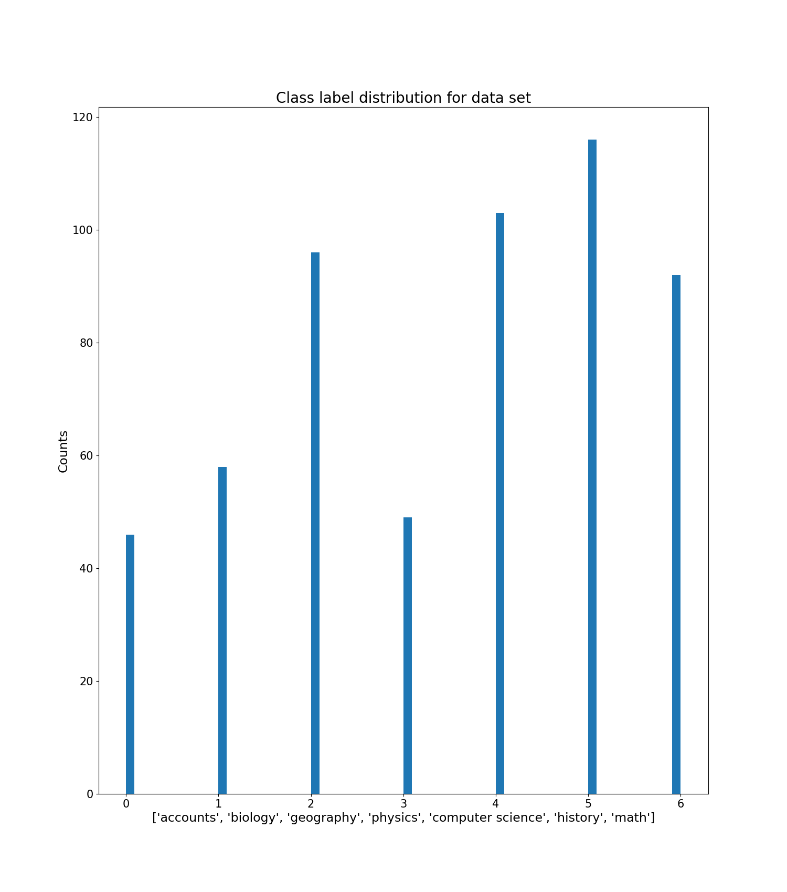
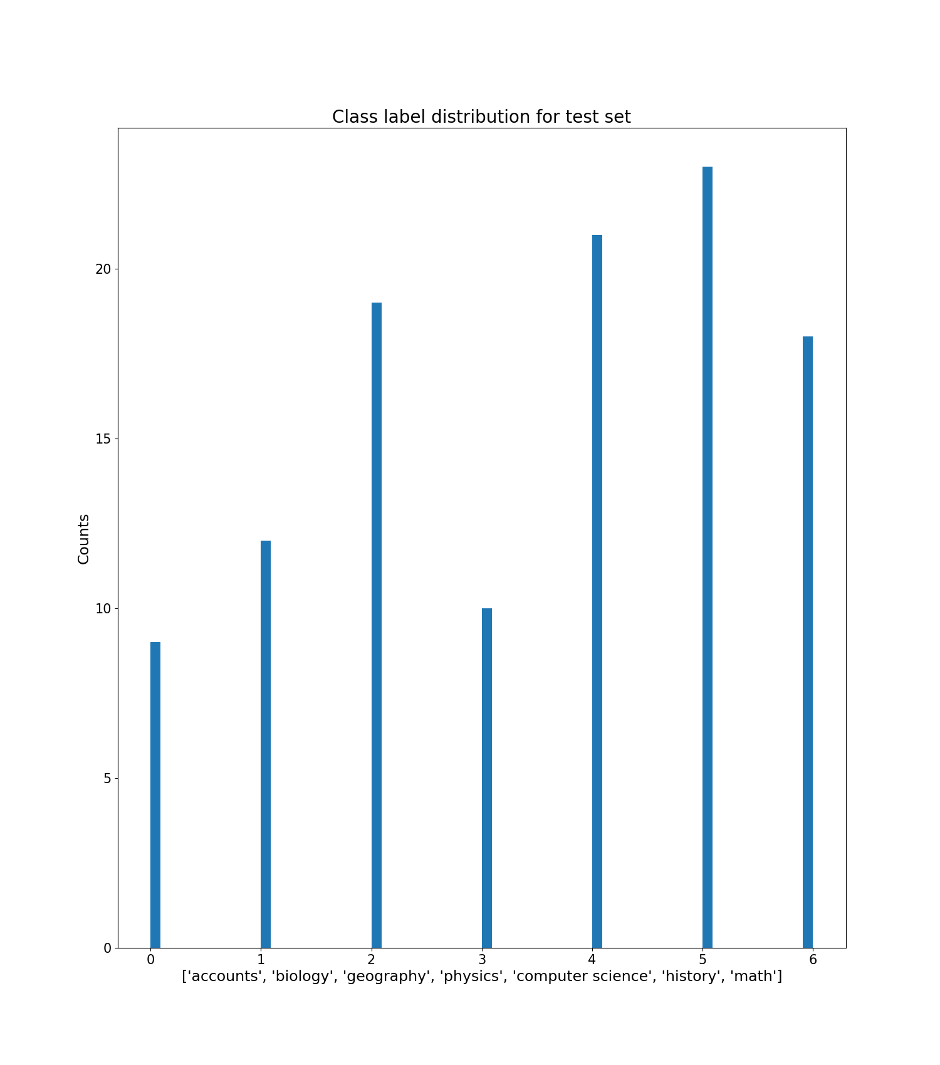

Slide 44
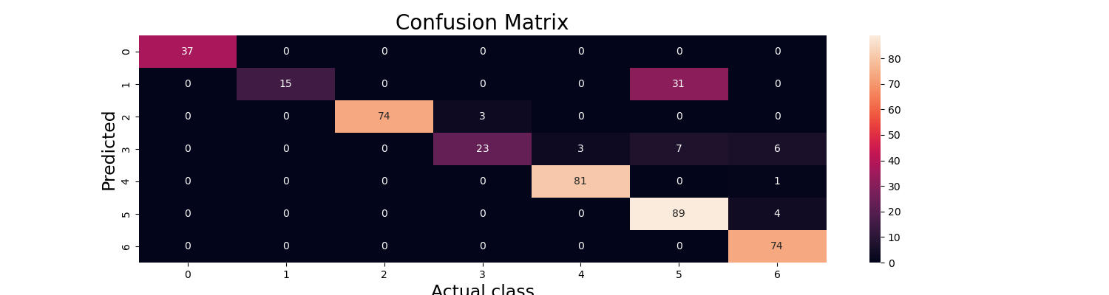
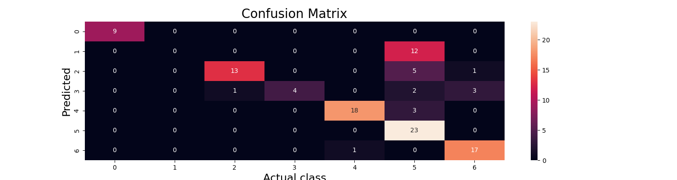

Slide 45
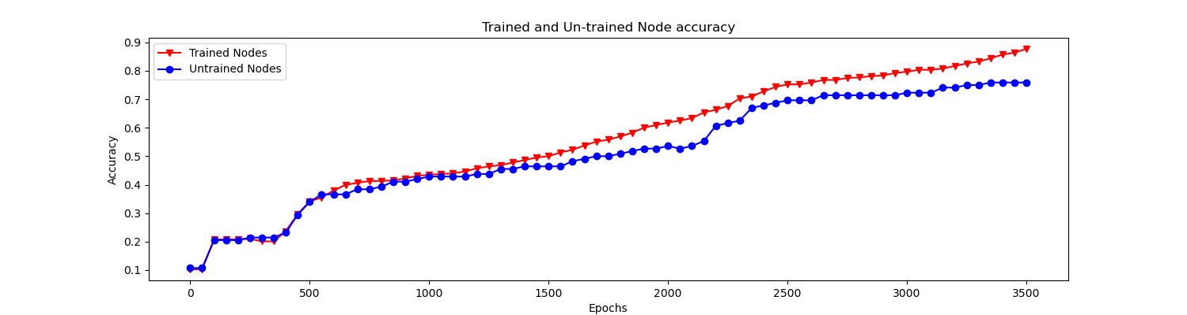
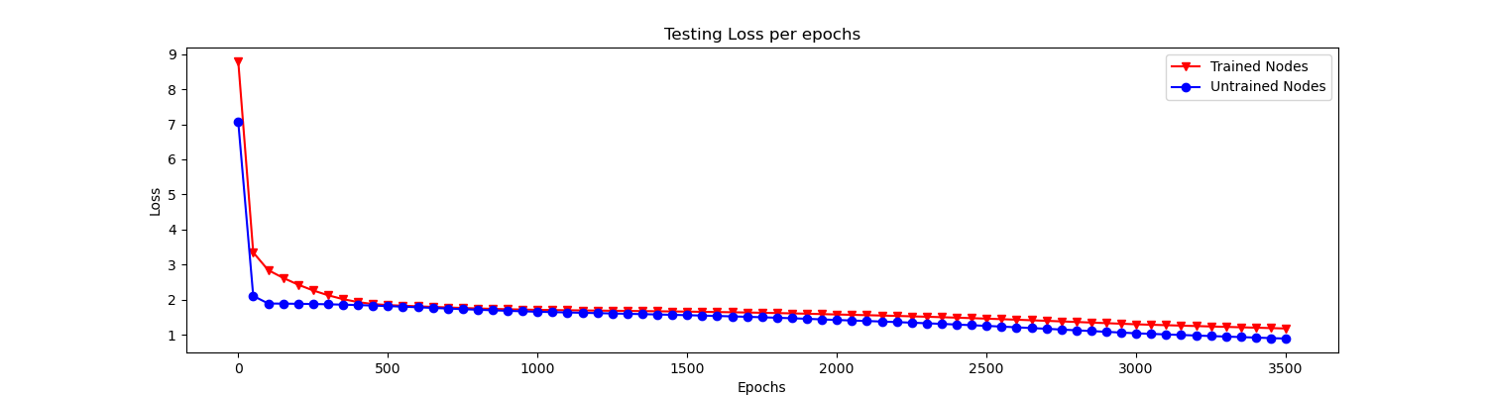

Slide 46
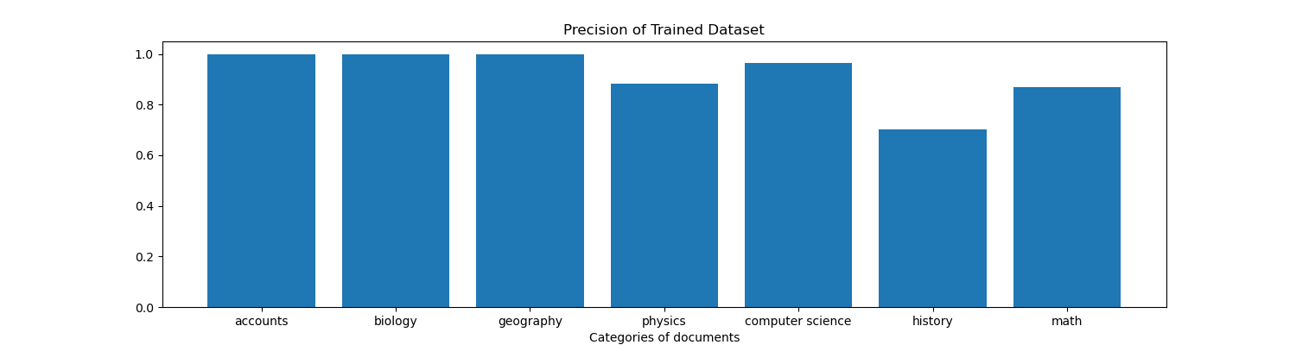
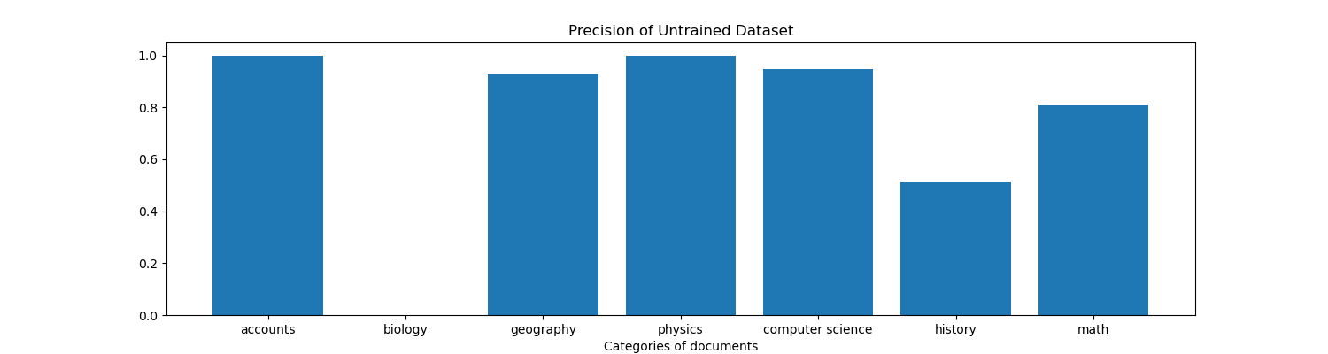

Slide 47
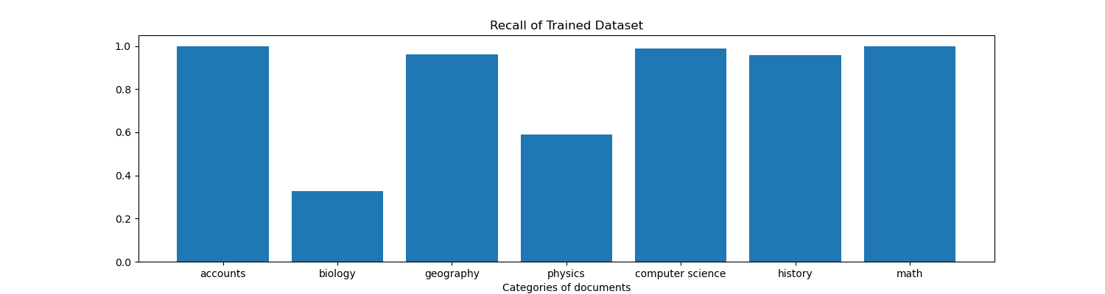
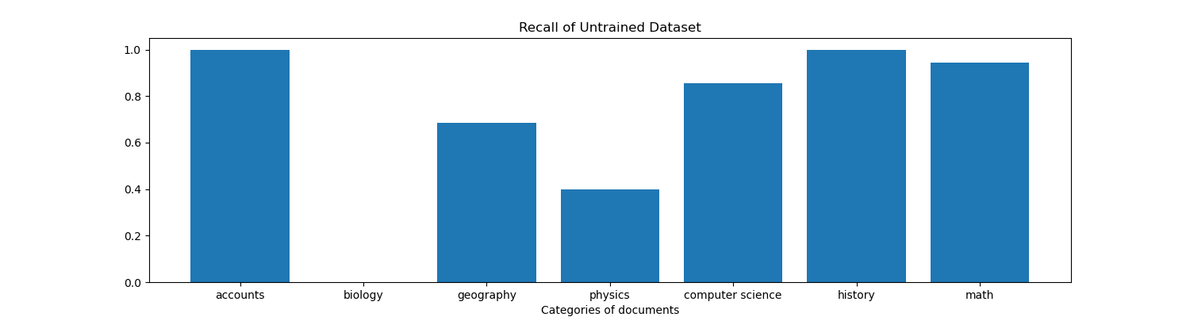

Slide 48



Slide 49


1000 Number of Input Files

Slide 50



Slide 51



Slide 52



Slide 53



Slide 54



Slide 55



Slide 56

Output Calculation:
Give input to the model then you will get output.
Get index of highest value in the output.
In above case, its index 0. And index 0 is a predicted value.
Then count how many predicted values are same as actual values. That calculated value will be correct number of values.
Then we calculate accuracy = correct number of values i.e. actual value = predicted values / length of predictions

